Slide 1
Chapter 13 Chemical Kinetics

Slide 2
Kinetics: Introduction
Studies the rate at which a chemical process occurs.
Have we taken for granted that all reactions will occur just because we can write a balanced chemical equation for them?
EX: H₂ (g) + I₂ (g)
Notes:
Draw on board. Go through the diatomic molecules lewis structures. Talk about how the reactants have to decide to break apart and form different bonds even though they had octets already. Show the energy complex H-H and I-I → square with 2 Hs and 2Is → 2 H-I. Introduce activation energy…show the hump that must over come to get to the eventual lower energy.

Slide 3
Factors That Affect Reaction Rates
1) Physical State of the Reactants
Molecules must come in contact with each other.
The more homogeneous the mixture of reactants, the faster the molecules can react.
2) Concentration of Reactants
As this increases, so does the likelihood that reactant molecules will collide.
3) Temperature
At higher temperatures, reactant molecules have more kinetic energy, move faster, and collide more often and with greater energy.
4) Presence of a Catalyst
Catalysts speed up reactions by changing the mechanism of the reaction.
Catalysts are not consumed during the reaction.
Notes:
COLLISION THEORY….temp is the most important factor. All biological processes and really just chemical processes. Throw a bunch of stuff together and things will collide. Positive and negative catalyst (CATALYST will LOWER THE ACTIVATION ENERGY…drop the hump). DON’T FORGET SURFACE AREA when looking at solids!!!

Slide 4
Rate of Reaction
Reaction rates are determined similar to velocity (change in distance over change in time)
Instead, they look at the change in concentration over the change in time ($\frac{Δ [A]}{Δ t}$)
Example with 1:1 ratio of coefficients:
A → B
At time 0 s, A has concentration of 1.0 M and B obviously has concentration of 0 M
Let’s say that 2 s later, A’s concentration went to 0.98 M
Notes:
Show that B must now be 0.02 M
Show the ΔB of 0.02 – 0 / 2-0 equals a rate of 0.01.
Show the ΔA of 0.98 – 1.0 / 2-0 equals the same but with a negative sign
Write the rate expression R=Δ [B]/Δ t = - Δ [A]/Δt

Slide 5
Rate of Reaction: Example when coefficients are NOT 1:1
2N₂O₅ → 4NO₂ + O₂
Let’s say that O₂ form at a rate of +9.0 x 10⁻⁶ M/s
So then, what would be the rate of formation of NO₂? Must be four times that of O₂, right?
4 x +9.0 x 10⁻⁶ M/s = +3.6 x 10⁻⁵ M/s
What does that say about the rate of disappearance of N₂O₅? Must be two times that of O₂, right?
2 x +9.0 x 10⁻⁶ M/s = -1.8 x 10⁻⁵ M/s
Notes:
Go to board…show +9.0 x 10⁻⁶ M/s = ? times+3.6 x 10⁻⁵ M/s = - ? times 1.8 x 10⁻⁵ M/s
OR then Rate = $\frac{\text{Δ}\text{ [}\text{O}\text{2]}}{\text{Δ} t}$ =$\frac{\text{1}}{\text{4}}$ $\frac{\text{Δ}\text{ [}\text{N}\text{O}\text{2]}}{\text{Δ} t}$ = - $\frac{\text{1}}{\text{2}}\frac{\text{Δ}\text{ [}\text{N}\text{2}\text{O}\text{5}\text{]}}{\text{Δ} t}$

Slide 6
Rate Expressions
To generalize, then, for the reaction
aA + bB
cC + dD
1
a
Δ[A]
Δt
1
b
Δ[B]
Δt
1
c
Δ[C]
Δt
1
d
Δ[D]
Δt
Rate = −
= −
=
=

Slide 7
Increasing the Concentration of Reactants
aA + bB → products
Experiment # | [A] | [B] | Initial Rate (M/s)
1 | 1.00 M | Constant | 0.01
2 | 2.00M | Constant | 0.02
3 | Constant | 1.00 M | 0.01
4 | Constant | 2.00 M | 0.04
Notes:
lower case a and b are just coefficients. WE DO NOT USE COEFFICIENTS WITH THIS TYPE OF DATA!!!! WE USE THE DATA INSTEAD!!
Evaluate the two reactants separately. We want to see how the individually affect the initial rate. Let’s start with A. Choose two experiments where A changes but B is held constant. Experiments 1 and 2.
↑[A] x 2 and ↑R x 2
So ask, 2^{x} = 2….x must be 1. Thus the reaction rate proportionate to [A]¹. We call this 1st order with respect to A
Do B….Experiments 3 and 4 hold A constant while B changes.
↑[B] x 2 and ↑R x 4
So ask, 2^{y} = 4….y must be 2. Thus the reaction rate proportionate to [B]². We call this 2nd order with respect to B

Slide 8
Continued…
Thus the rate law for this is:
R = k [A]¹[B]²
First order in respect to A. Second order in respect to B…Third order overall
k is called the rate constant…stays the same even as concentration of reactants change.
R, the Rate, will change but k, the rate constant, will not.

Slide 9
Units of k
Units of the rate constant vary
They depend on the order of the reaction
Let’s look at the most common overall all orders of reactions:
Overall order | Example rate law | Units of k
0th | R = k[A]⁰ | M/s
1st | R = k[A]¹ | 1/s
2nd | R = k[A]¹[B]¹ or R = k[A]² | $$\frac{1}{M·s}$$
Notes:
When you raise to a power of 1, 2, 3, etc….the M’s powers change
R = k [A]^{x}[B]^{y}
R is always M/s but what you divide it by depends on the x and y (the powers of the M’s)

Slide 10
Example with a real reaction
2 NO + 2H₂ → N₂ + 2H₂O
Experiment | [NO] (M) | [H₂] (M) | Initial Rate (M/s)
1 | 0.0050 | 0.0020 | 1.25 x 10⁻⁵
2 | 0.0100 | 0.0020 | 5.00 x 10⁻⁵
3 | 0.0100 | 0.0040 | 1.00 x 10⁻⁴
Write the rate law.
What is the overall order?
Find the value of k.
What is the rate when NO is 0.012 M and H₂ is 0.0060 M?
Notes:
ANSWER: R = k[NO]²[H₂]¹
Third order overall
Finding k….
USE THE FIRST INITIAL RATE (BUT YOU CAN USE ANY OF THE 3)
R = k[NO]²[H₂]¹
1.25 x 10⁻⁵M/s = k[0.0050 M]²[0.0020M]¹
K = 250 $\frac{1}{M2∗s}$
R = k[NO]²[H₂]¹
R = 250 $\frac{1}{M2∗s}$ [0.012 M]²[0.0060M]¹
R = 2.2 x 10⁻⁴ M/s

Slide 11
Integrated Rate Laws: 1st order
Using calculus to integrate the rate law for a first-order process gives us:
ln [A]_{t} − ln [A]₀ = − kt
[A]₀ is the initial concentration of A.
[A]_{t} is the concentration of A at some time, t, during the course of the reaction.

Slide 12
Example
The conversion of cyclopropane to propene is a first order reaction with a rate constant of 6.7 x 10⁻⁴ s⁻¹ at 500 degrees C. If the initial concentration of cyclopropane is 0.0500 M, what is the concentration of cyclopropane after 30 minutes?
Notes:
ln [A]_{t} − ln [A]₀ = − kt
ln [A]_{t} = − kt + ln [A]₀
ln [A]_{t} = −6.7 x 10⁻⁴ s⁻¹ x 30 min x $\frac{60 s}{1 min}$ + ln [0.0500M]
TAKE e^ to both sides…do left side first
ANSWER = 0.015 M

Slide 13
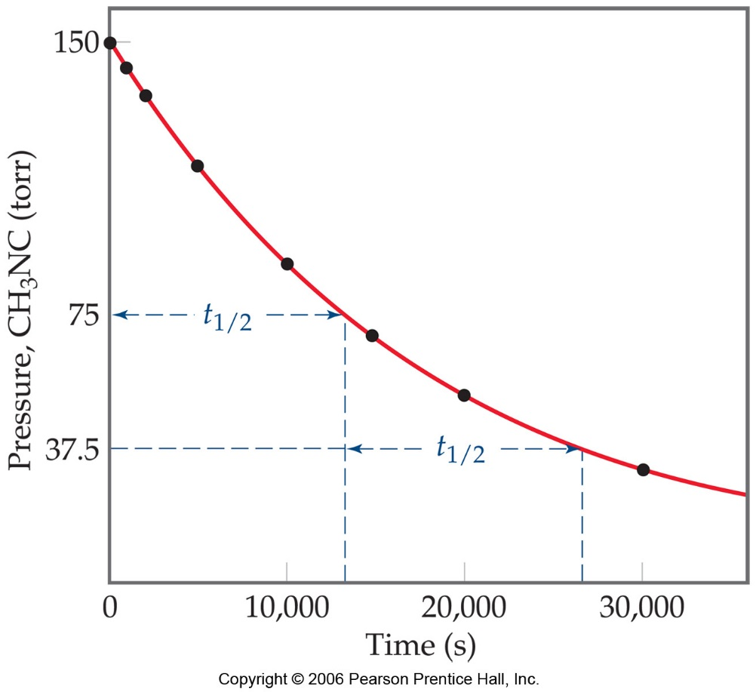
Half-Life
Half-life is defined as the time required for one-half of a reactant to react.
Because [A] at t_{1/2} is one-half of the original [A],
[A]_{t} = 0.5 [A]₀.

Slide 14
Half-Life
For a first-order process, this becomes:
0.693
k
= t_{1/2}
NOTE: For a first-order process, the half-life does not depend on [A]₀.

Slide 15
1st Order Half Life Example
Hydrogen peroxide goes from 1.00 M to 0.500 M in 2.16 x 10⁴ s. Assuming that this is a first order reaction, find k.
0.693
k
= t_{1/2}
Notes:
0.693/k = 2.16 x 10⁴ s
K = 3.21 x 10⁻⁵ 1/s

Slide 16
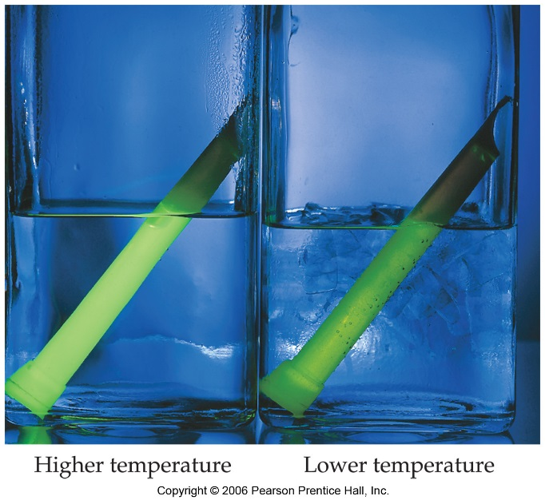
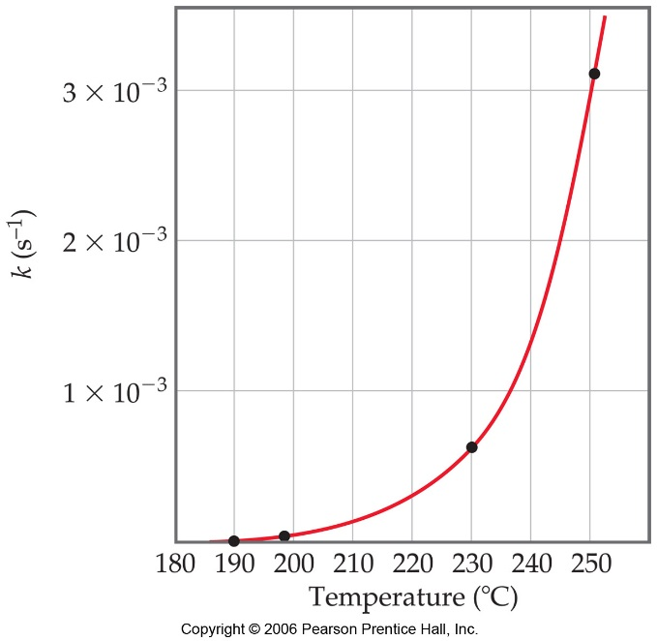
Temperature and Rate
Generally, as temperature increases, so does the reaction rate.
This is because k is temperature dependent.

Slide 17
The Collision Model
In a chemical reaction, bonds are broken and new bonds are formed.
Molecules can only react if they collide with each other.
Furthermore, molecules must collide with the correct orientation and with enough energy to cause bond breakage and formation.

Slide 18
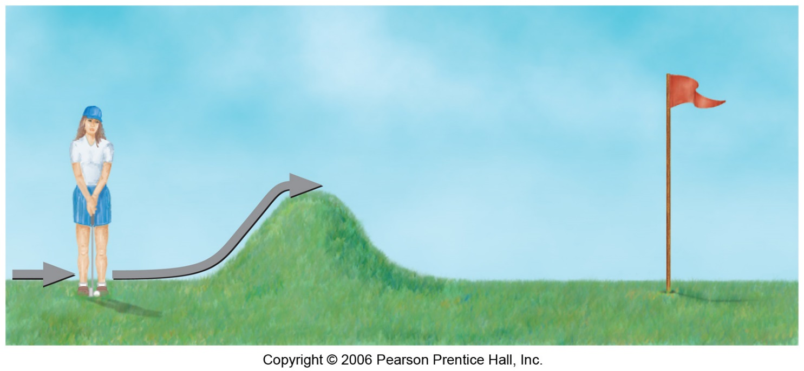
Activation Energy
In other words, there is a minimum amount of energy required for reaction: the activation energy, E_{a}.
Just as a ball cannot get over a hill if it does not roll up the hill with enough energy, a reaction cannot occur unless the molecules possess sufficient energy to get over the activation energy barrier.

Slide 19
Arrhenius Equation to Calculate E_{a}
Ln k₂ = - E_{a} 1 - 1
k₁ R T₂ T₁
R is 8.314 J-mol/K. Thus E_{a} will be in Joules

Slide 20
Example
Rate constants for the isomerization of methyl isocyanide are listed below. Find the activation energy (in kJ/mol) from 470 K to 510 K.
T (K) | k (s⁻¹)
470 | 5.79 x 10⁻⁵
480 | 1.36 x 10⁻⁴
490 | 3.10 x 10⁻⁴
500 | 6.81 x 10⁻⁴
510 | 1.45 x 10⁻³
Notes:
Ln($\frac{k2}{k1 }$) = - $\frac{Ea}{R}$ x ($\frac{1}{T2} − \frac{1}{T1})$
Ln ($\frac{1.45 x 10−3}{5.79 x 10−5}$) = - $\frac{Ea}{8.314}$ x ($\frac{1}{510} − \frac{1}{470})$
3.2206 = - $\frac{Ea}{8.314}$ x (-1.6688 x 10⁻⁴)
Ea = 16045 J/mol = 160 kJ/mol

Slide 21
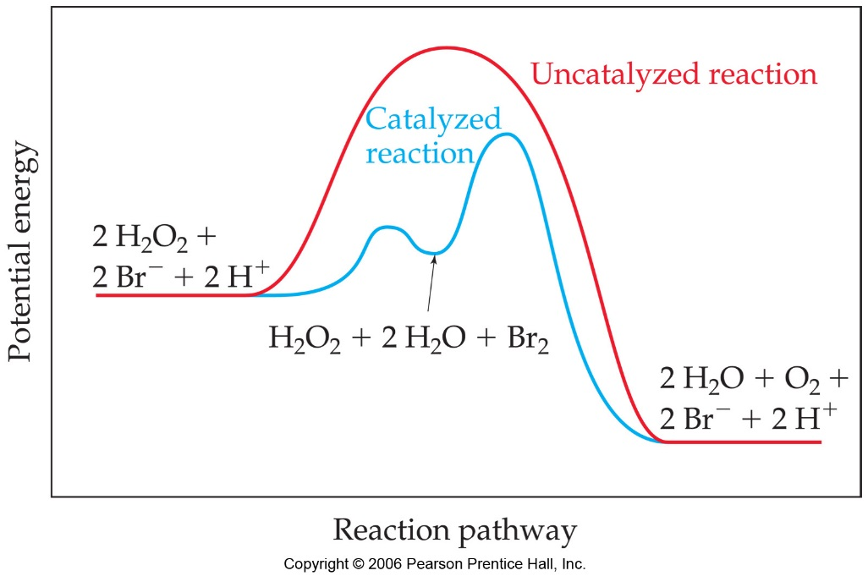
Catalysts
Catalysts increase the rate of a reaction by decreasing the activation energy of the reaction.
Catalysts change the mechanism by which the process occurs.

